Slide 2
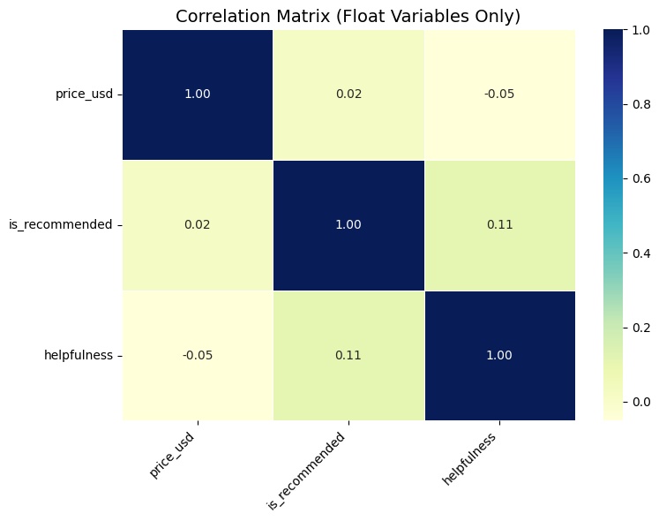
Helpful reviews influence recommendations more than price.

Slide 3
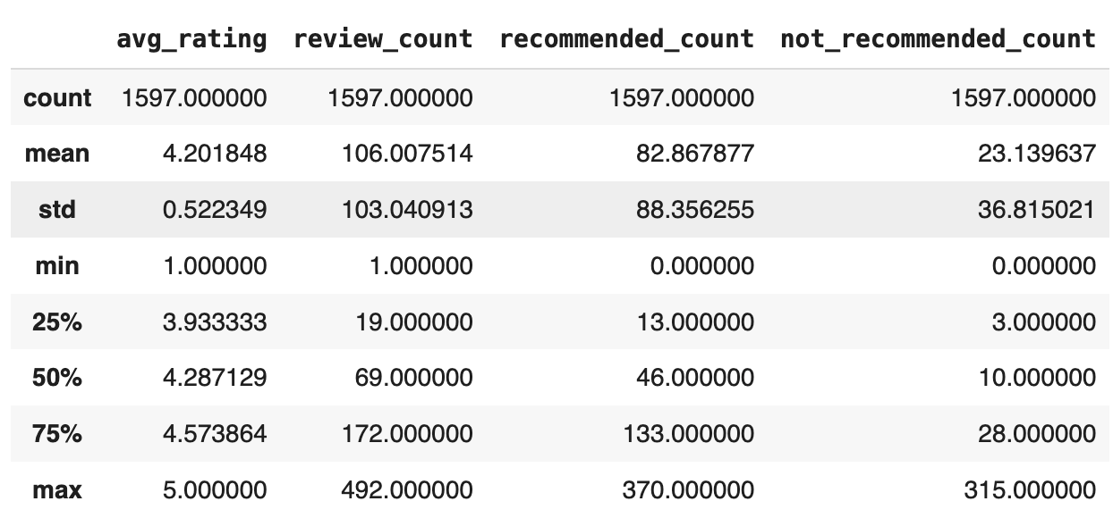

Remove?
1. Very few reviews
Fewer than 10 reviews
2. Low engagement & negative sentiment
Between 10–18 reviews, and:
Average rating ≤ 2
Not recommended ratio ≥ 75%
Products to remove: 224
Products to keep: 1373

Slide 4
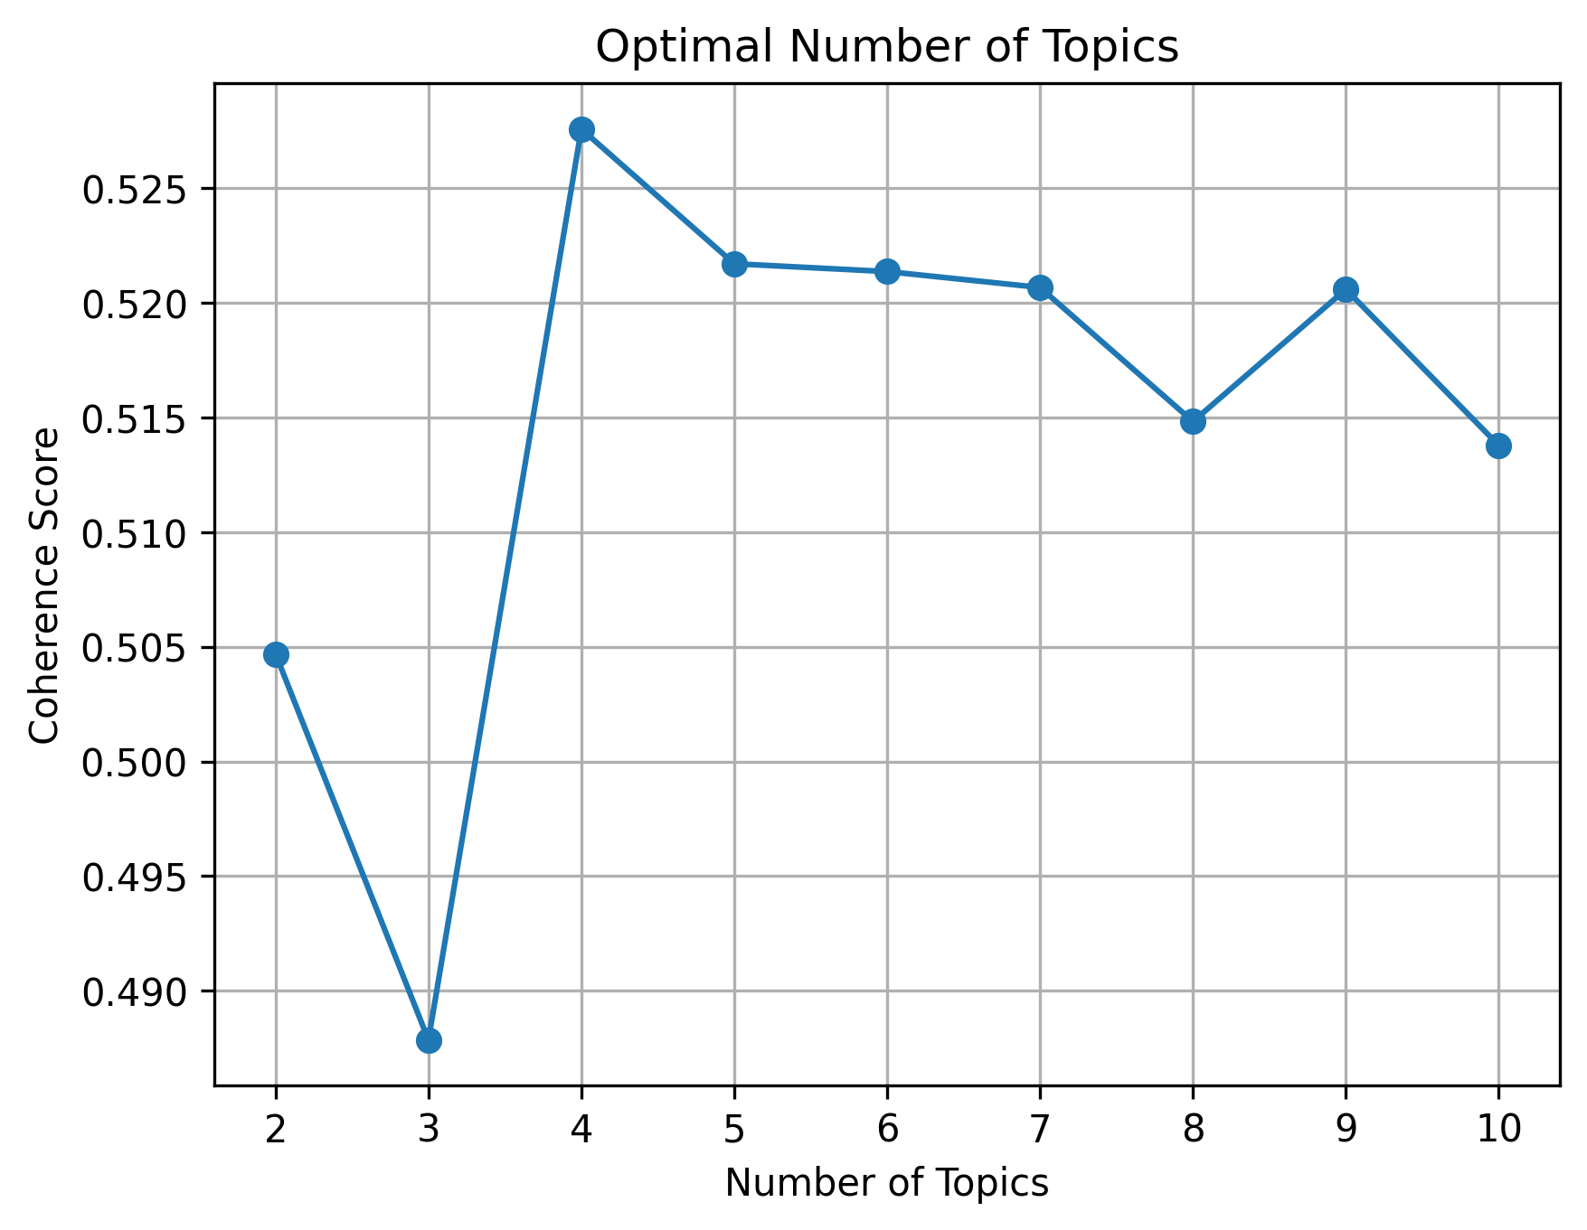
Topic coherence measures how meaningful and consistent the topics are.
The highest coherence score was reached with 4 topics.
Indicates that 4-topic LDA produces the most interpretable themes from negative reviews.

Slide 5
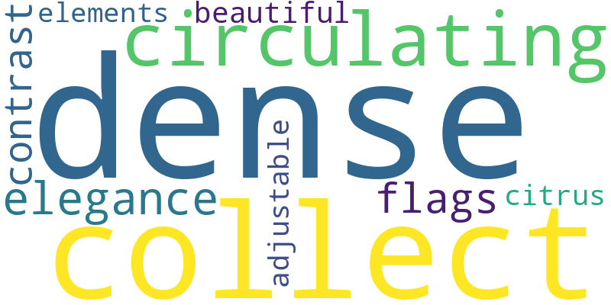
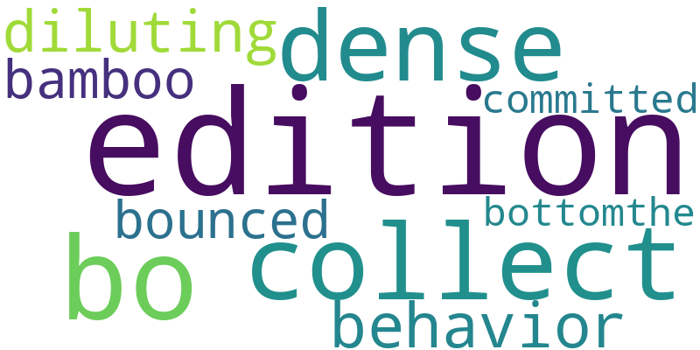
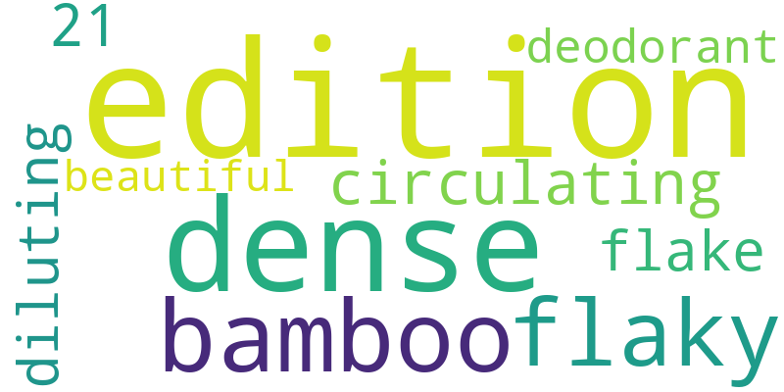
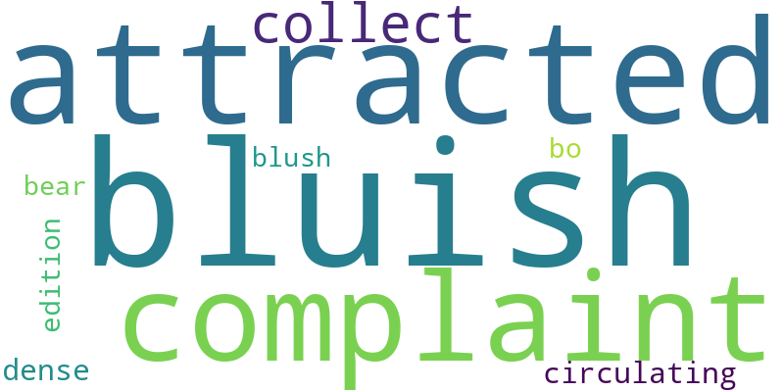
Topic | Image | Content
1 |  | Luxury vs Practicality Clash Frequent words: collect, dense, elegance, contrast, circulating Insight: Users may feel the product focuses too much on aesthetics or luxury appeal, while lacking in real performance or practicality.
2 |  | Texture & Irritation Issues Frequent words: edition, deodorant, dense, bamboo, flaky Insight: Complaints suggest flaky or irritating consistency, especially in deodorants or scented products, leading to dissatisfaction.
3 |  | Unnatural Texture & Confusion Frequent words: edition, collect, dense, behavior, bamboo Insight: Customers mention confusing or inconsistent texture, possibly tied to limited edition or dense formulations that don’t blend well.
4 |  | Color & Skin Reaction Concerns Frequent words: attracted, bluish, complaint, blush, collect Insight: Some customers report strange coloration or unexpected skin reactions like a bluish tint, indicating sensitivity or mismatched expectations.

Slide 6
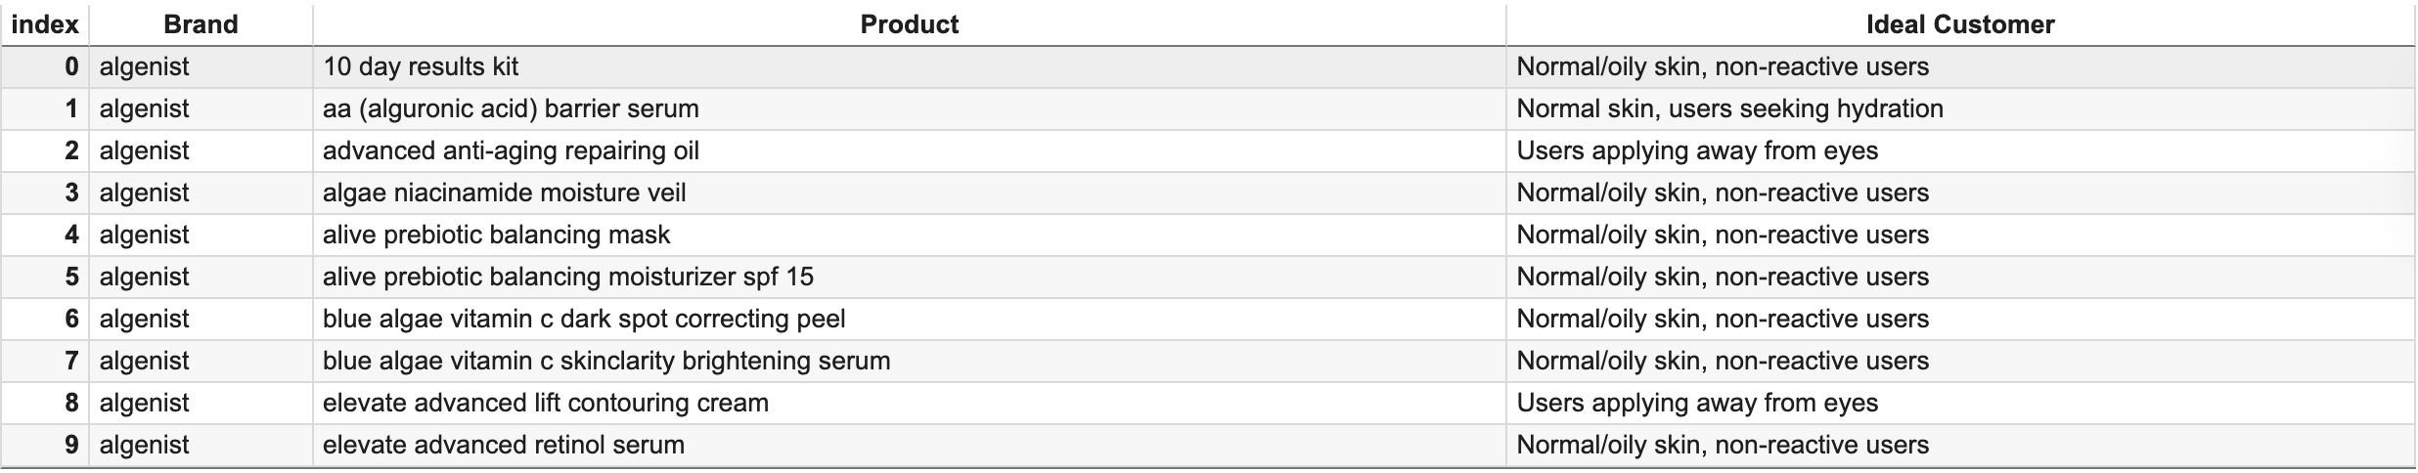
Specific skincare products were mapped to their ideal customer profiles based on NLP-driven topic modeling of low-rated reviews.

Slide 7
Used SQL to filter, join, and prepare structured review data for analysis.
Applied NLP topic modeling (LDA) to uncover key reasons behind low product ratings.
Built a Rule-Based Recommendation Engine to match products with ideal customer profiles.
Enabled targeted product positioning by predicting preferences based on reviews and ratings over time.
Result: A clearer path to personalized skincare recommendations and better customer satisfaction.

